Slide 1
JUnit introduction
Course “JUnit magic”
Section 2

Slide 2
Agenda
JUnit introduction
Simple test example
Assertions
Test flow control

Slide 3
JUNIT INTRODUCTION

Slide 4
JUnit introduction
A programmer - oriented testing framework
Developers: Kent Beck, Erich Gamma
Writen in Java
License: Common Public License

Slide 5
JUnit introduction
JUnit is one of a family of unit testing frameworks collectively known as xUnit
JUnit is a single jar file named – junit-x.x.jar
Javadoc: http://junit.sourceforge.net/javadoc/

Slide 6
Where to find JUnit?
Site: http://junit.org/
Use Maven dependency

Slide 7
Quiz
Download Junit Workshop project from GitHub
https://github.com/javagurulv/junit_magic_2020
Run: “gradlew clean build” command

Slide 8
SIMPLE TEST EXAMPLE

Slide 9
Simple test example
Tax Calculator example
Implement business rule:
  Income up to 20000 is taxed at 25%

Slide 10
Simple test example
Interface:
public interface TaxCalculator {
double calculateTax(double income);
}

Slide 11
Simple test example
Interface implementation:
public class TaxCalculatorImpl
implements TaxCalculator {
public double calculateTax(double income) {
return 0;
}
}

Slide 12
Simple test example
Test class:
public class TaxCalculatorImplTest {
@Test
public void incomeUpTo20000() {
TaxCalculator calculator = new TaxCalculatorImpl();
double income = 100;
double expectedTax = income * 0.25;
double diviation = 0,001;
double realTax = calculator.calculateTax(income);
assertEquals(expectedTax, realTax, diviation);
}
}
PS: Math.abs(realTax - expectedTax) < diviation

Slide 13
Simple test example
public class TaxCalculatorImplTest {
@Test
public void incomeMore20000() {
// test code
}
}
Test class does not derive from any class
@Test indicates a unit test
Free unit test method name

Slide 14
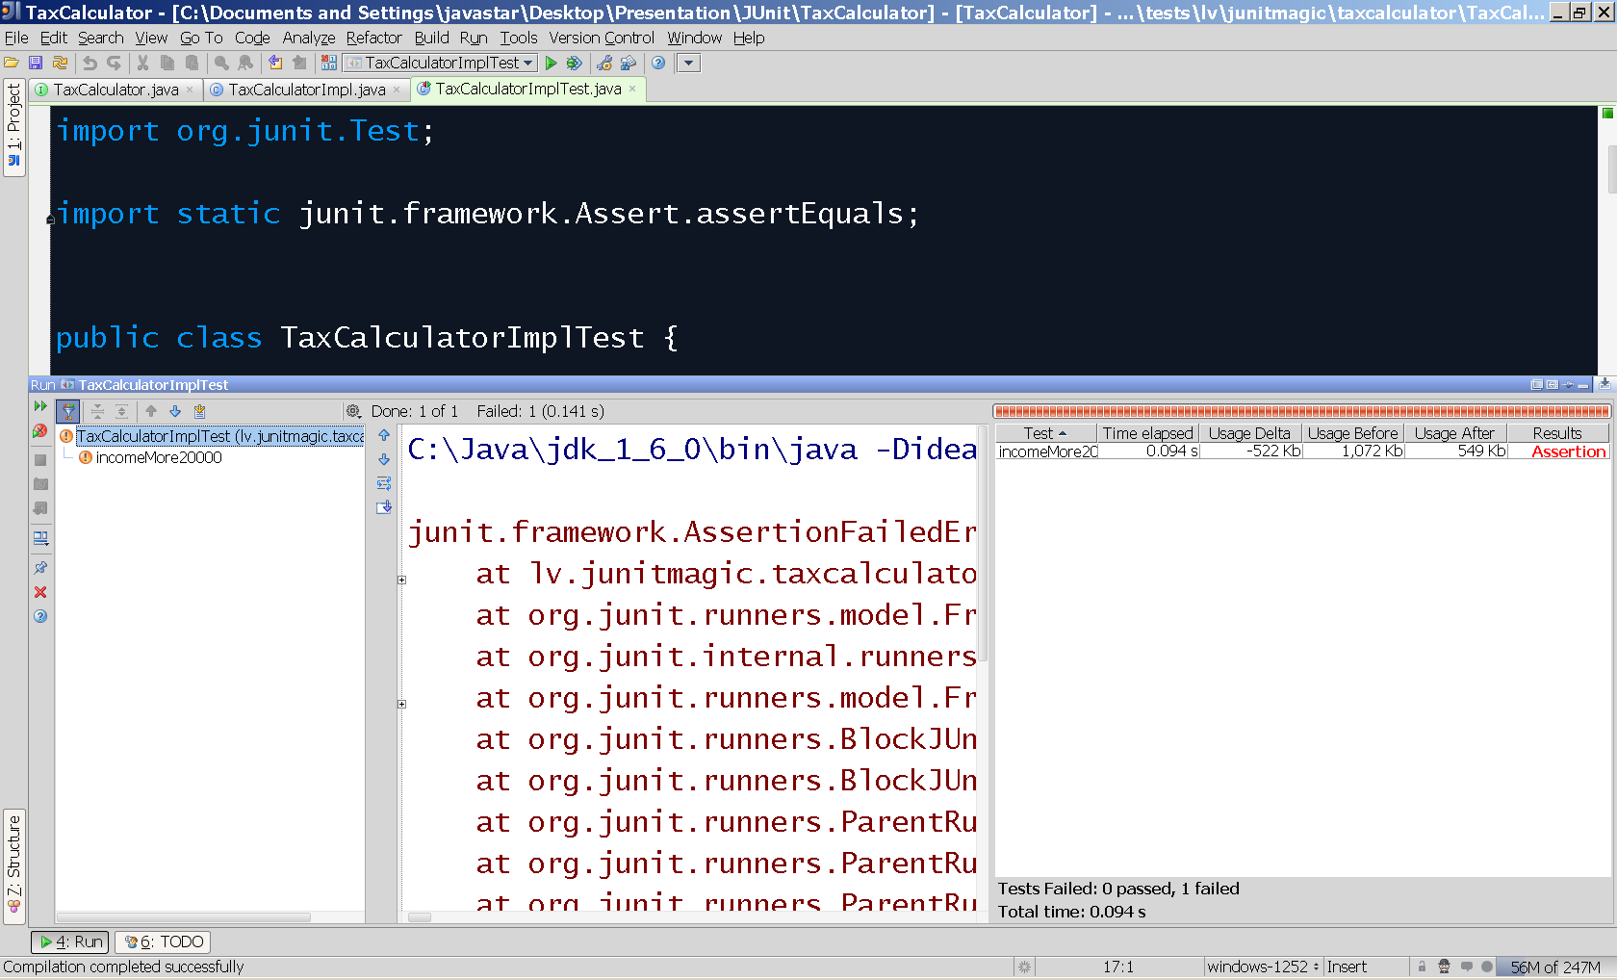
Simple test example
Test execution bar red = failed tests

Slide 15
Quiz
Create more tests for business rule:
  Income up to 20000 is taxed at 25%
Case 1: income = 0, tax = 0
Case 2: income = 20000, tax = 5000
Case 3: income > 20000, tax = ?

Slide 16
Simple test example
Functionality implementation:
public class TaxCalculatorImpl
implements TaxCalculator {
public double calculateTax(double income) {
if(income <= 20000) {
return income * 0.25;
}
return 0;
}
}

Slide 17
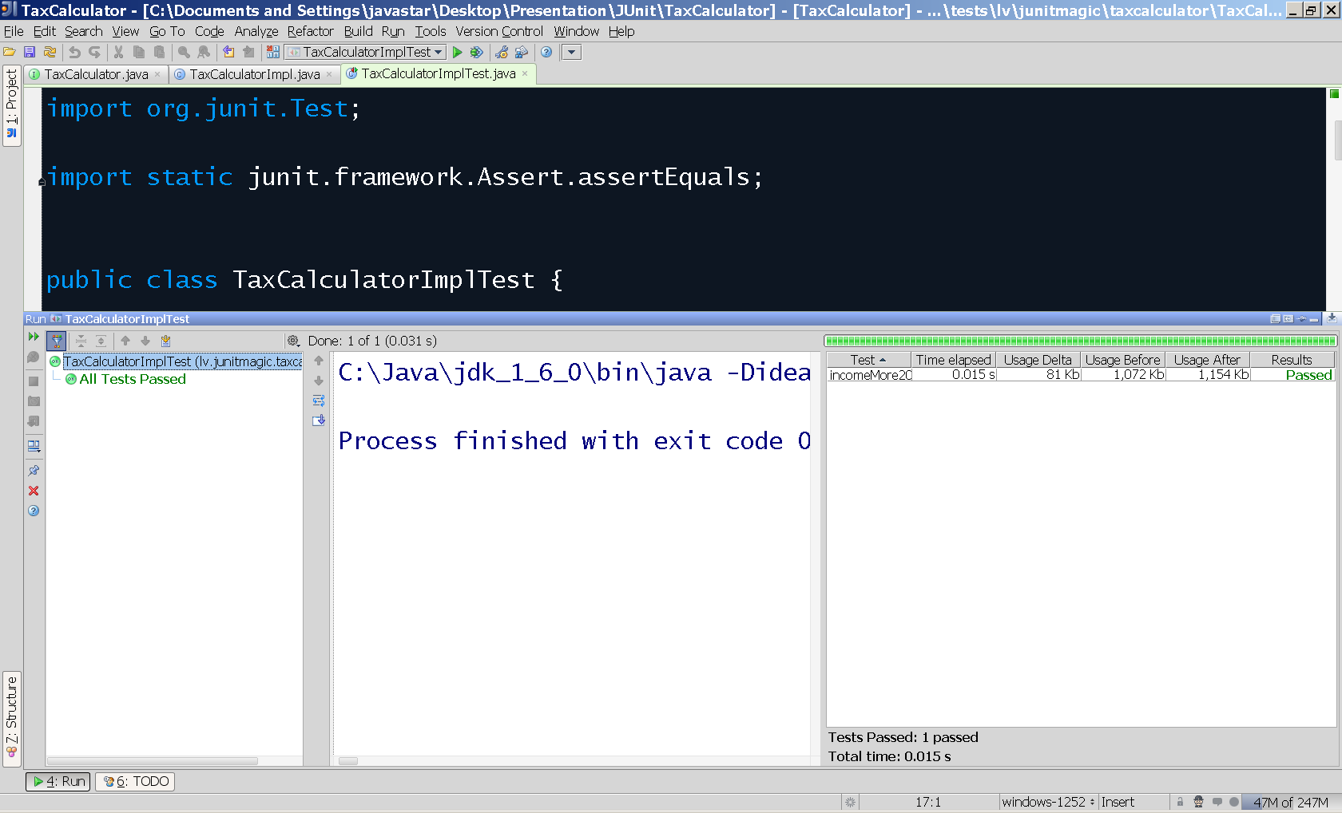
Simple test example
Test execution bar green = passed tests

Slide 18
Quiz (create test cases)
Create tests for new business rule:
New business rule:
  Income of more than 20000 is taxed at 40%
  Example: income = 30000
    Income <= 20000, tax 25% = 5000
    Income > 20000 = 10000, tax 40% = 4000
    Total tax = 5000 + 4000 = 9000

Slide 19
Quiz (write implementation)
Create implementation of new business rule:
New business rule:
  Income of more than 20000 is taxed at 40%
  Example: income = 30000
    Income <= 20000, tax 25% = 5000
    Income > 20000 = 10000, tax 40% = 4000
    Total tax = 5000 + 4000 = 9000

Slide 20
ASSERTIONS

Slide 21
Assertions
How to check the test results?
How to fail the test automatically, if result not correct?

Slide 22
Assertions
How to check the test results?
Use Assert class methods:
  assertEquals(…)
  assertNotNull(…)
  assertNull(…)
  assertTrue(…)
  assertFalse(…)
  assertArrayEquals(…)

Slide 23
Assertions
How to fail the test, if result not correct?
Assert methods automatically
throws AssertionError, if assertion fails!
Junit framework collect statistics about failed tests and present it to programmer.

Slide 24
Assertions
assertTrue() and assertFalse():
boolean result = testMethod(…);
assertTrue(result);
boolean result = testMethod(…);
assertFalse(result);

Slide 25
Assertions
assertTrue() and assertFalse():
@Test
public void myTest() {
assertTrue(Boolean.FALSE);
}
This test fails with AssertionError

Slide 26
Assertions
assertNull() and assertNotNull():
Object result = testMethod(…);
assertNull(result);
Object result = testMethod(…);
assertNotNull(result);

Slide 27
Assertions
assertEquals():
Double expectedPvn = 180.0;
Double realPvn = calculatePvn(…);
assertEquals(expectedPvn, realPvn);

Slide 28
Assertions
assertEquals() method is overloaded:
  assertEquals(long expected, long actual)
  assertEquals(int expected, int actual)
  …
  assertEquals(Object expected, Object actual)
    use Object.equals() method for comparison

Slide 29
TEST FLOW CONTROL

Slide 30
Test flow control
Annotations for test flow control:
  @BeforeClass
  @Before
  @Test
  @After
  @AfterClass

Slide 31
Test flow control
@BeforeClass – run before any test
@Before – run before each test
@Test
@After – run after each test
@AfterClass – run after all tests

Slide 32
Test flow control
Business rule:
  Losses should not be taxed

Slide 33
Test flow control
Duplicate initialization:
@Test
public void lossesShouldNotBeTaxed() {
TaxCalculator calculator = new TaxCalculatorImpl();
double realTax = calculator.calculateTax(-1000);
assertEquals(0, realTax);
}
@Test
public void incomeMore20000() {
TaxCalculator calculator = new TaxCalculatorImpl();
double realTax = calculator.calculateTax(20001);
assertEquals(20001 * 0.25, realTax);
}

Slide 34
Test flow control
public class TaxCalculatorImplTest {
private TaxCalculator calculator;
@Before
public void setUp() {
calculator = new TaxCalculatorImpl();
}
@Test
public void lossesShouldNotBeTaxed() {
double realTax = calculator.calculateTax(-1000);
assertEquals(0, realTax);
}
@Test
public void incomeMore20000() {
double realTax = calculator.calculateTax(20001);
assertEquals(20001 * 0.25, realTax);
}
Executed before each test

Slide 35
Test flow control
public class TaxCalculatorImplTest {
private TaxCalculator calculator;
@Before
public void setUp() {
calculator = new TaxCalculatorImpl();
}
@After
public void clean() {
calculator = null;
}
Executed after each test

Slide 36
Test flow control
public class TaxCalculatorImplTest {
private static TaxCalculator calculator;
@BeforeClass
public void setUp() {
calculator = new TaxCalculatorImpl();
}
@AfterClass
public void clean() {
calculator = null;
}
Executed once before any test is executed
Executed once after every test has
been executed

Slide 37
Test flow control
Flow sequence:
  @BeforeClass
    @Before
      @Test
    @After
    @Before
      @Test
    @After
  @AfterClass

Slide 38
Quiz
Remove TaxCalculator instantiation from each test
Use @Before annotation and special setUp() method to create TaxCalculator instance before each test
Keep your tests clean and simple as possible!

Slide 39

Questions

Slide 40
References
http://www.junit.org/
http://members.pingnet.ch/gamma/junit.htm
http://www.manning.com/massol/
http://martinfowler.com/bliki/tags/testing.html

